Slide 1
Partial Migration by a Large Wading Bird in a Highly Unpredictable Environment
Simona Picardi, Rena Borkhataria, Peter Frederick, Mathieu Basille
@simopicardi
simona.picardi@ufl.edu

Slide 2
The Many Faces of Migration
Thomson 1926
Pattern:
Periodic
Recurring
Alternating
Function:
Track suitable environmental conditions

Slide 3
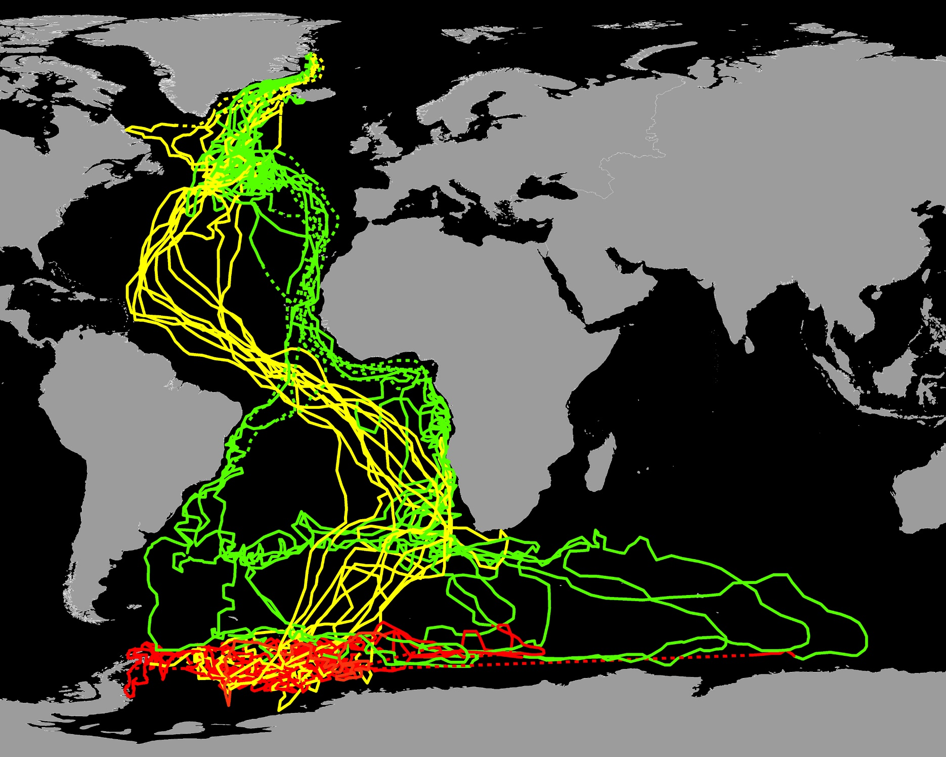
The Many Faces of Migration
Seasonality
“Classic” back-and-forth migration

Slide 4
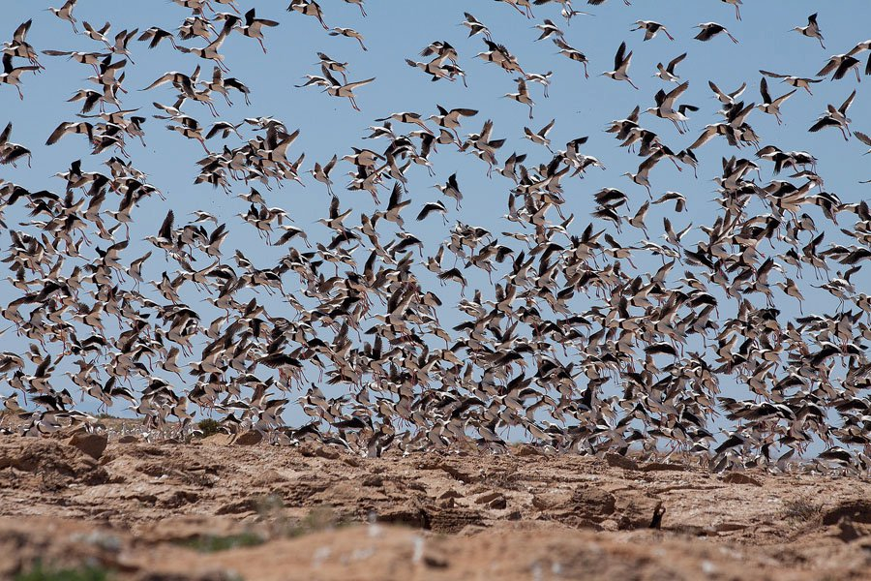
The Many Faces of Migration
Resource breakouts
Erratic migration

Slide 5
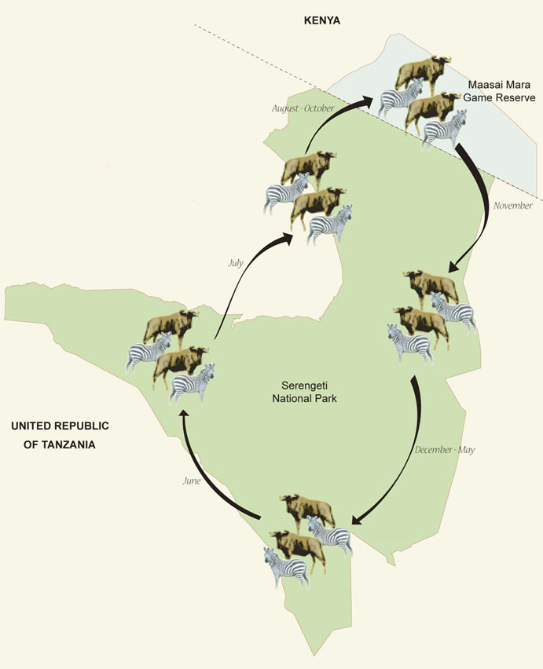
The Many Faces of Migration
Trade-offs in resource acquisition
Partial migration

Slide 6
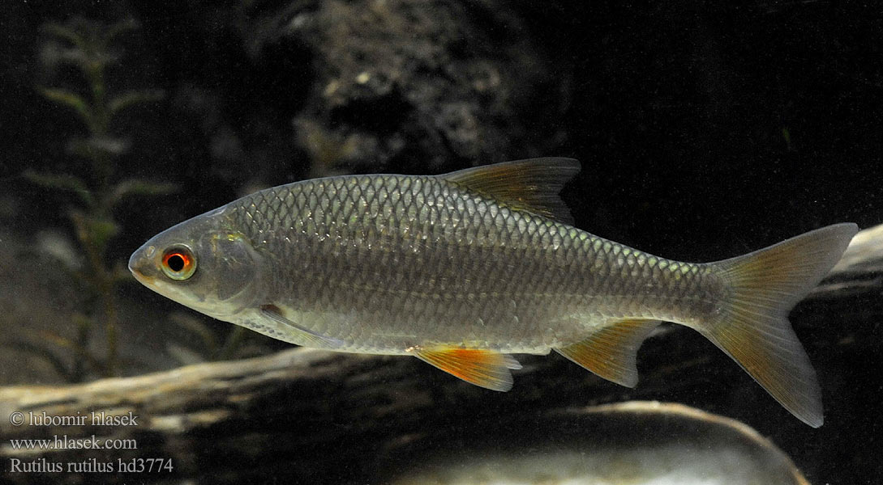
The Many Faces of Migration
Unpredictability
Facultative migration
Partial + Facultative

Slide 7
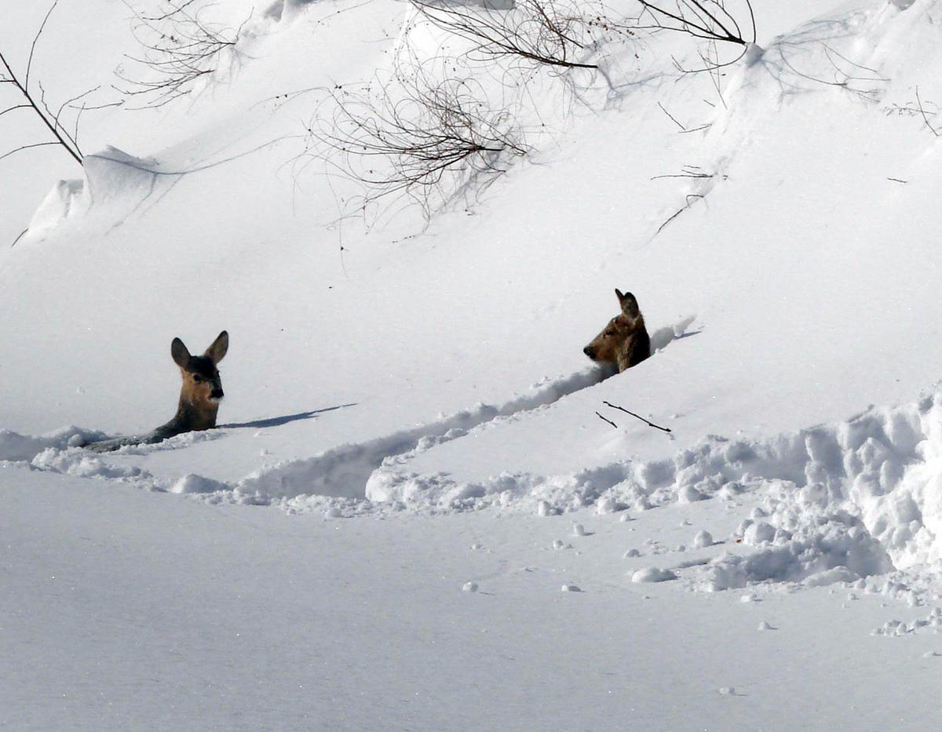
The Many Faces of Migration
More migratory
Less migratory

Slide 8
The Many Faces of Migration
Pattern of resource variation
Migration pattern

Slide 9
Wetlands
Unpredictability

Slide 10
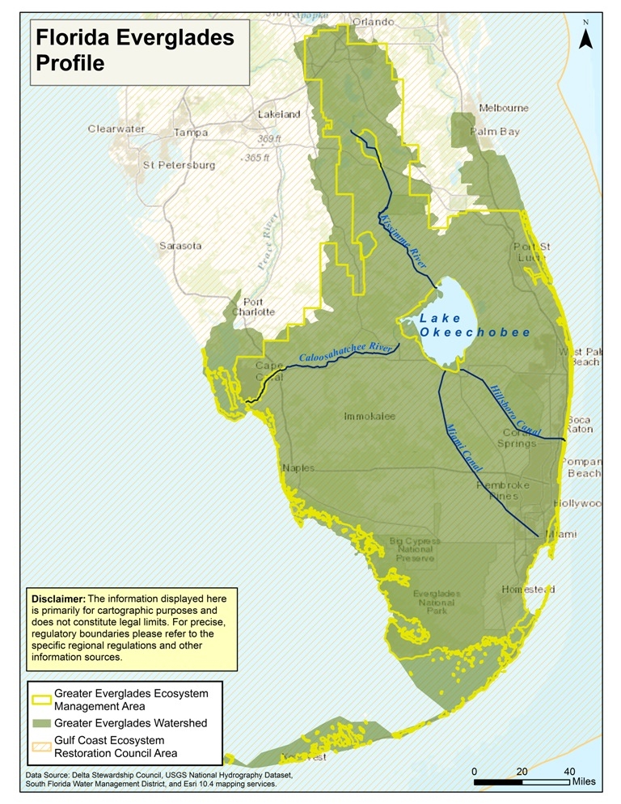
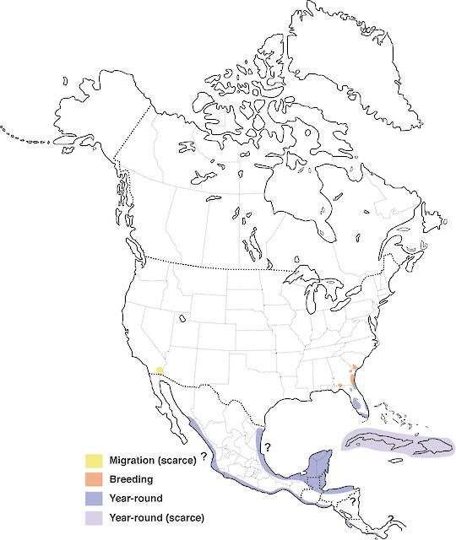
Wood Storks

Slide 11
Wood Storks
Fish need to be concentrated

Slide 12
Hydrological Dynamics
Wet season
Dry season
Fish production
Fish concentration

Slide 13
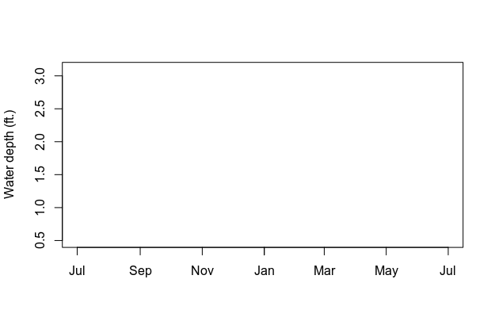
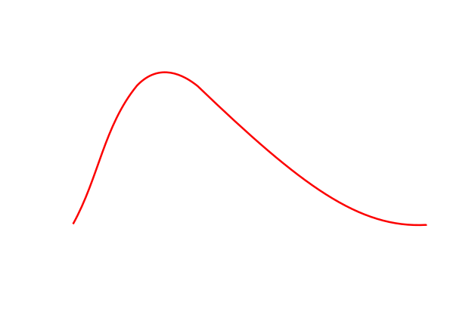
Hydrological Dynamics
Wet season
Dry season

Slide 14
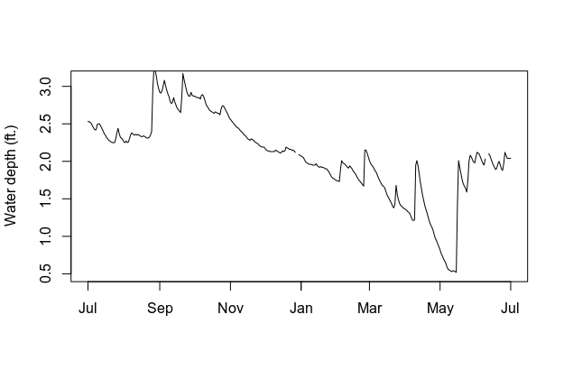
Hydrological Dynamics
Wet season
Dry season
2005

Slide 15
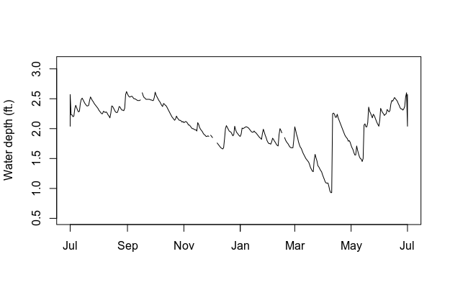
Hydrological Dynamics
Wet season
Dry season
2006

Slide 16
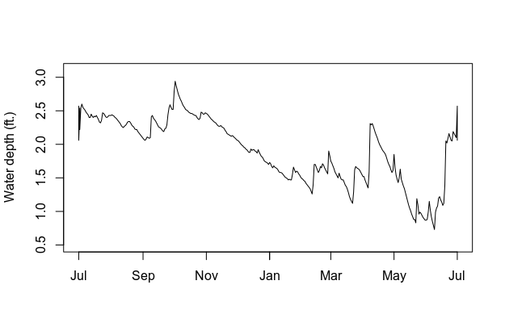
Hydrological Dynamics
Wet season
Dry season
2007

Slide 17
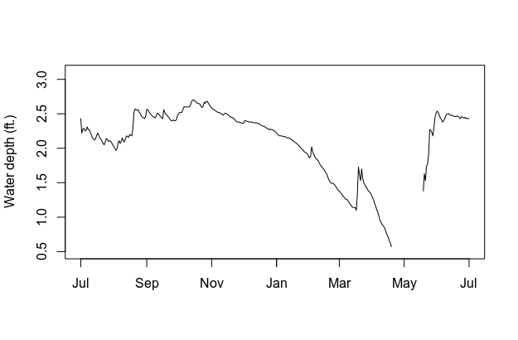
Hydrological Dynamics
Wet season
Dry season
2008

Slide 18
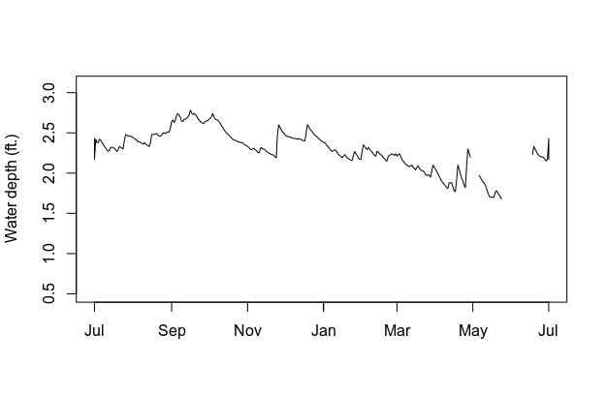
Hydrological Dynamics
Wet season
Dry season
2009

Slide 19
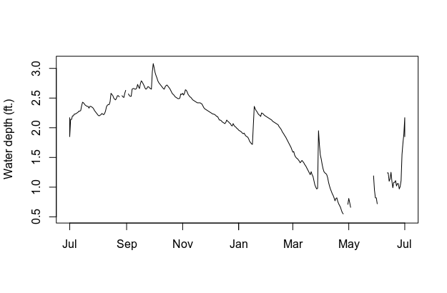
Hydrological Dynamics
Wet season
Dry season
2010

Slide 20
Wood Stork Movements

Slide 21
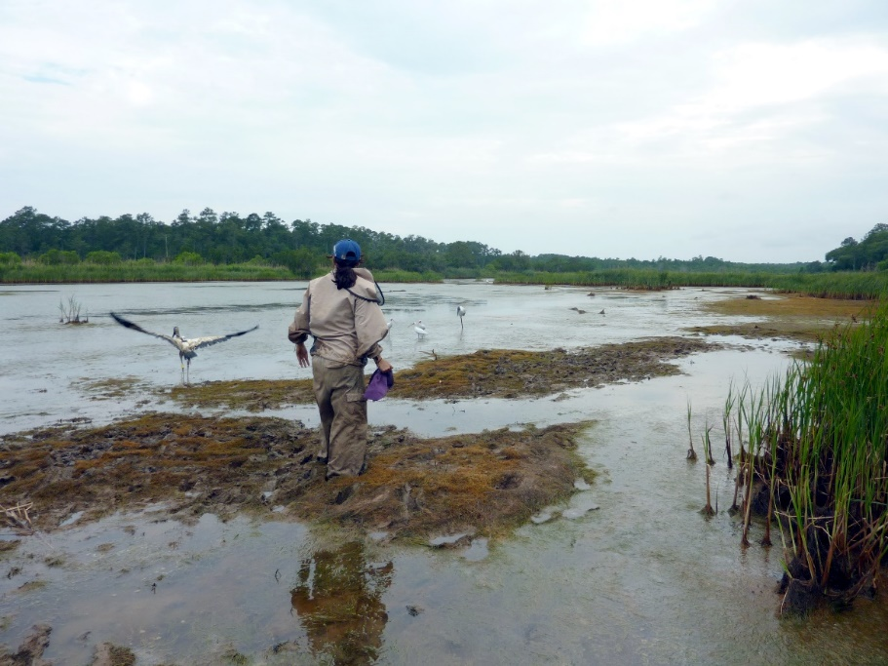
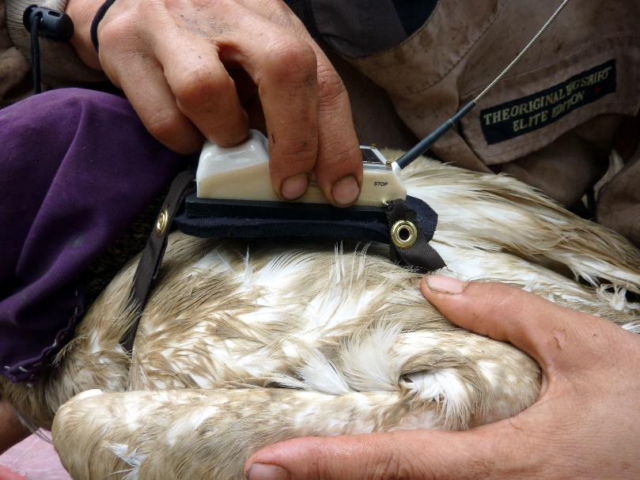
The Tracking Project
Captures performed in 2004-2012 by Rena Borkhataria et al.

Slide 22
Data Analysis
Migratory choice: y/n (each year)
Net Squared Displacement

Slide 23
Data Analysis
Migratory choice: y/n (each year)
Net Squared Displacement

Slide 24
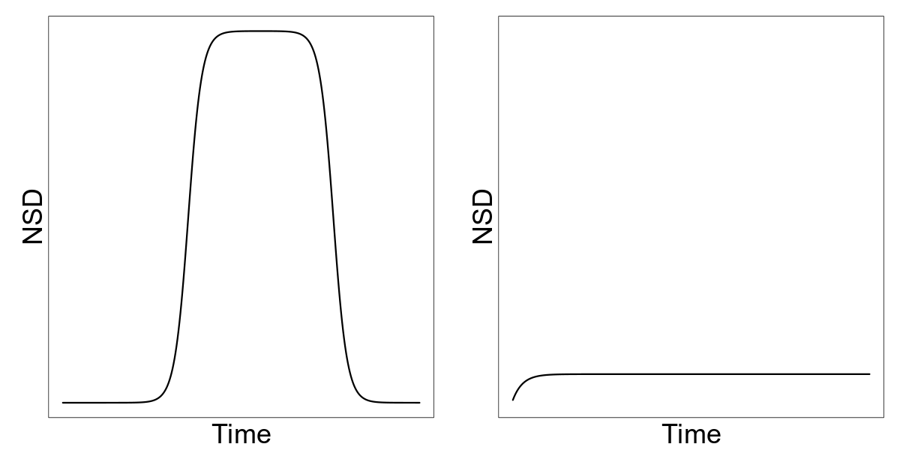
Data Analysis
Migratory choice: y/n (each year)
Final dataset: 200 individual years from 64 individuals
Net Squared Displacement
Package ‘migrateR’
Fit set of alternative non-linear models to NSD data
Migrant
Resident
Model selection by AIC

Slide 25
Data Analysis
Final dataset: 200 individual years from 64 individuals

Slide 26
Migratory Choices
121 migrations (60%)
79 residencies (40%)

Slide 27
Migratory Choices
121 migrations (60%)
79 residencies (40%)

Slide 28
Migratory Strategies
Tracking periods: 1-10 years, mean = 4

Slide 29
Migratory Strategies
Consistent migrants

Slide 30
Migratory Strategies
Consistent residents

Slide 31
Migratory Strategies
Facultative migrants

Slide 32
Seasonal Distribution of Migrants
Summer
Winter

Slide 33
Migration Start Dates
Spring
Fall

Slide 34
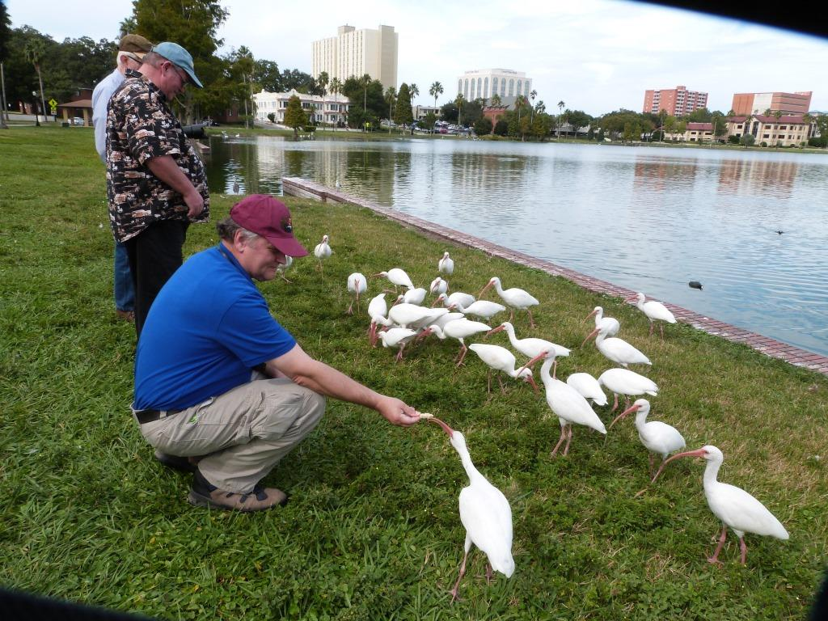
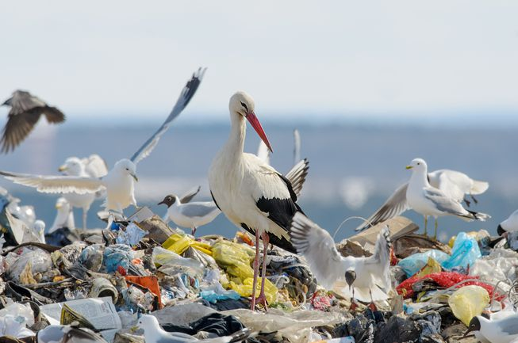
Year-round Distribution of Residents

Slide 35
Partial Migration in
Unpredictable Environments
Tradeoffs in resource acquisition
Unpredictability
Partial + Facultative Migration
Bet-hedging strategy?

Slide 36
Future Directions
Estimate reproductive outcome of tracked storks
Compare reproductive outcome of migrants vs. residents in different hydrological conditions

Slide 37
Thank You!

Slide 38
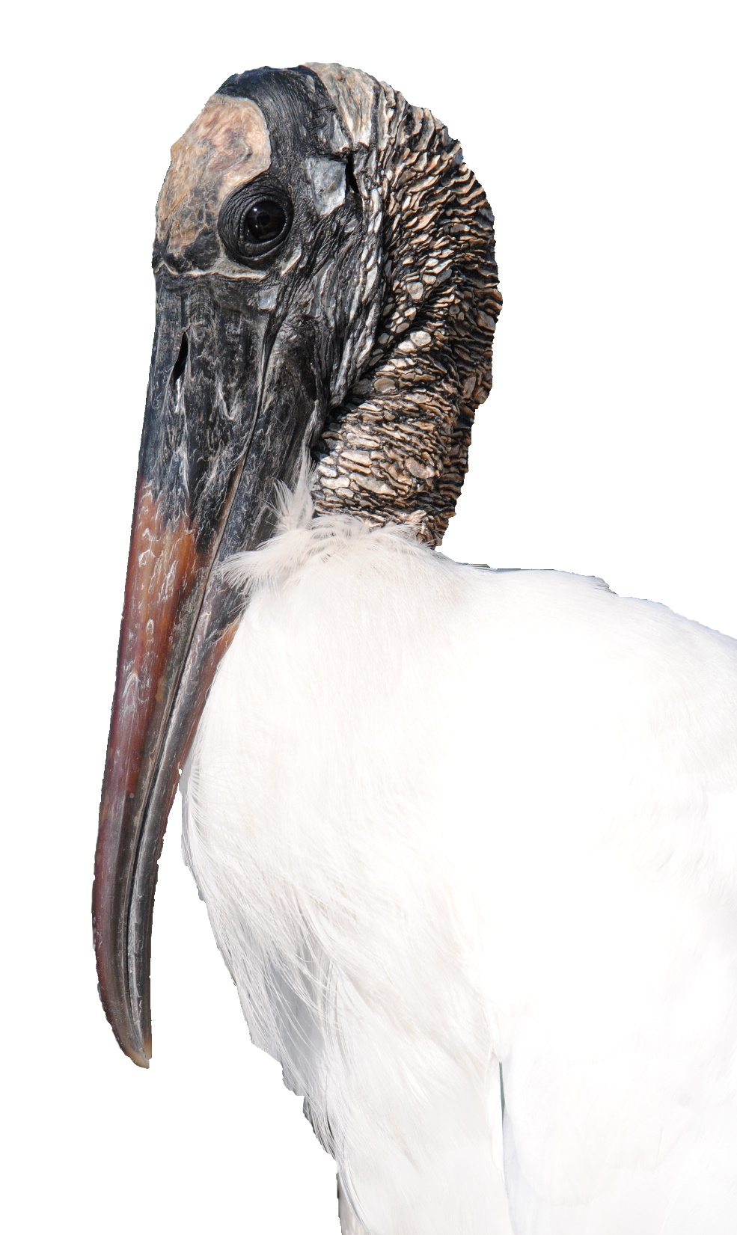
Thank You!
Photo credits:
Barb Gonzalez, Jens Birch, Andrew Allen, Helena Holton, Ben Parkhurst, Tringa Photography, Lubomir Hlasek, Roman Kozhichev, Grzegorz Lesniewski, Luca Giordano, Garry Lomas, Aileen Shu, Lee, Shutterstock, David Bucklin, Rena Borkhataria
simona.picardi@ufl.edu
@simopicardi

